Slide 1
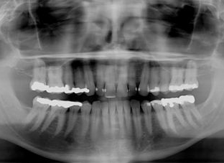
Mercury Fillings : The Poison in Your Teeth
By: Andrew Corke

Slide 2
The Issue:
Safer Alternative filling materials are now available but dentist still choose to place silver amalgam fillings which have been proven to leak dangerous amounts of mercury vapor.
I believe the lack of regulation on this issue is heading down a road towards large scale problems with pollution in the environment and the degradation of our overall health.

Slide 3
My Personal Beef with Mercury:
My dad, Mark Corke DDS, FAGD has been practicing dentistry for 32 years.
He is a "Fellow" in the Academy of General Dentistry (FAGD). To earn the FAGD, a dentist must complete a minimum of 500 continuing dental education credit hours, pass a comprehensive exam and have been an AGD member for three continuous years
With his profession he has dealt first hand with mercury exposure and is a living example of its effects. In the years of his being a dentist he has cleaned or removed countless silver amalgam fillings. It was not known until recently that these silver amalgam fillings release the most amount of vapor when being extracted with a high powered drill. His health was being directly effected by this chronic mercury poisoning and for the last five years he has been practicing both mercury free and mercury safe dentistry.

Slide 4
Show of Hands
How many of you have silver amalgam fillings?
How many of you knew that these fillings contained mercury?
A 2006 Poll by Zogby International: 76 percent of Americans don’t know mercury the primary component of amalgam fillings
http://mpp.cclearn.org/wp-content/uploads/2008/08/whatpatientsdontknow.pdf

Slide 5
Some Important Definitions:
A mercury free dentist has made the conscientious decision not to place mercury fillings.
A mercury safe dentist has the training, experience, skills and specialized equipment to make your dental visits as mercury-safe as possible.
Amalgam - a mixture containing two or more metallic elements or metallic and nonmetallic elements usually fused together or dissolving into each other when molten
Dental amalgam is a dental filling material used to fill cavities caused by tooth decay. It has been used for more than 150 years in hundreds of millions of patients.
Dental amalgam is a mixture of metals, consisting of liquid mercury and a powdered alloy composed of silver, tin, and copper. Approximately 50% of dental amalgam is elemental mercury by weight.
Source http://www.fda.gov/MedicalDevices/ProductsandMedicalProcedures/DentalProducts/DentalAmalgam/ucm171094.htm

Slide 6
Mini Timeline of Events
The early 1800s saw the advent and popularization of the dental chair and dental drill. However, there was still no cheap long-term filling material, and as a result most teeth were extracted instead of being filled.
Prior to the invention of the amalgam filling, the most commonly used dental filling materials were thin sheets of lead that could be layered into a tooth's cavity and pounded together to fill the tooth.
Gold foil fillings were also an option but were expensive and not yet perfected as a filling material.
1812: British Chemist Joseph Bell is credited with inventing mercury amalgam.
1816: Auguste Taveau of France creates the first dental amalgam, which is comprised of silver coins and mercury.
1833: The Crawcour brothers of France, who falsely represent themselves as dentists in New York, bring mercury amalgam fillings to the United States.
Source: (http://www.scribd.com/doc/54187396/Timeline-of-mercury-fillings)

Slide 7
Timeline Cont.
1840 - The first dental association, the American Society of Dental Surgeons (ASDS) was founded.
Their purpose was to standardize dental treatment and prohibit the use of amalgam fillings by member dentists.
Initially flourished. They banned the use of amalgam fillings by their members in 1843.
Members who continued to place amalgam fillings could risk loosing their license.
Dentists in fear of losing their license left the society.
1859 - The dentists who supported the use of amalgams got together to form their own dental administration – the American Dental Administration, the same association still regulates and controls the dental profession today.
Source: Tom McGuire, DDS, (2012). The Poison in Your Teeth: Mercury Amalgam fillings…Hazardous to Your Health! Sebastopol, California: The Dental Wellness Institute, LLC.

Slide 8
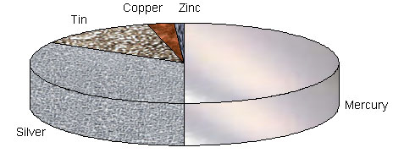
Why put Mercury in the fillings?
Mercury plays an essential role in the making of an amalgam filling, as important as water in making bread.
Mercury acts as a catalyst, dissolving and binding the powdered metals together to form a paste that can be placed into a prepared cavity.
Today the average amalgam filling consists of :
50% elemental mercury
50% powdered metals
Powdered Metals
69% Silver
26% Tin
4% Copper
1% zinc
Image source: (https://www.facebook.com/photo.php?fbid=10151095787818775&set=a.107482133774.96429.106947548774&type=1&theater

Slide 9
The average amalgam filling contains 1 gm of mercury
Source: (http://www.fda.gov/ohrms/dockets/dailys/02/Sep02/091602/80027dde.pdf)
(about the same amount as in a thermometer) which is enough to contaminate a 20 acre lake to the point where warnings not to eat any fish caught would be issued.

Slide 10
Mercury Facts
Mercury is the most poisonous, non-radioactive, naturally occurring
element on our planet.
Mercury is classified as a toxic metal, or Heavy Metal. Heavy metals refer to any metallic element that has a high density, or weight, and is poisonous in low concentrations.
A single Atom of mercury is poisonous to our body.
Mercury, being an element, cannot be broken down into anything
else but mercury – and it cannot be destroyed or changed.
Source: Print, Tom McGuire, DDS, (2012). The Poison in Your Teeth: Mercury Amalgam fillings…Hazardous to Your Health! Sebastopol, California: The Dental Wellness Institute, LLC.

Slide 11
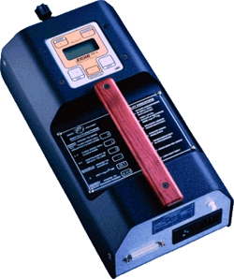
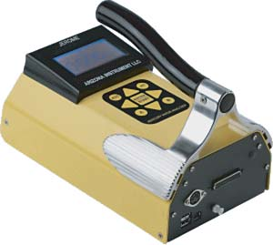
Technology
Today we have technological instruments that can measure the levels of mercury vapors.
Instruments include:
Mercury Vapor Gas analyzers
Electron dispersive X-ray analysis
Diffusive sampler
Image Source: (http://argus-hazco.com/gas-section/single-gas-monitors/jerome-j405-portable-mercury-vapor-analyzer.htm)
Image Source: (http://www.ierents.com/ProductInfo.aspx?productid=RAZIX431-0002)

Slide 12
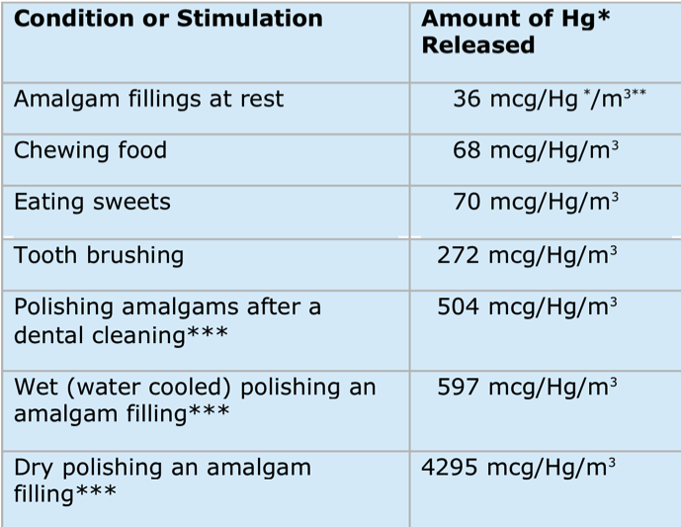
The Disturbing Science
Silver Amalgam fillings continuously release poisonous mercury vapor.
Any form of stimulation that heats the filling will increase the
release of vapor because the metal contracts and expands.
ex: drinking a hot beverage, chewing gum, tooth grinding ,even brushing and eating.
The expanding and contracting of the silver filling can also crack or fracture your tooth.
Source: Print, Tom McGuire, DDS, (2012). The Poison in Your Teeth: Mercury Amalgam fillings…Hazardous to Your Health! Sebastopol, California: The Dental Wellness Institute, LLC.

Slide 13
Heat is Key
Elemental mercury is different from other metals;
it Is liquid at room temperature. (68 Degrees Fahrenheit) and
It gives off a colorless, tasteless, odorless vapor at room temperature.
The more heat the more mercury vapor released
The oral cavity is 98.6 Degrees Fahrenheit

Slide 14
80% of the inhaled mercury vapor is absorbed in the blood through the lungs. It may cause harmful effects to the nervous, digestive, respiratory, immune systems and to the kidneys,
besides causing lung damage. Adverse health effects from mercury exposure can be: tremors, impaired vision and hearing, paralysis, insomnia, emotional instability, developmental deficits during fetal development, and attention deficit and developmental delays during childhood.
Source: (http://www.who.int/water_sanitation_health/medicalwaste/mercurypolpaper.pdf)

Slide 15
What Mercury Does in our Body:
After being inhaled:
As mercury accumulates in the body it can contribute to, or make every known health problem worse.
Mercury does damage on a cellular level
Elemental mercury is highly fat soluble, this characteristic allows it to readily pass through the membrane of every cell in the body including the brain.
Attaches to essential proteins and amino acids, enzymes.
Source: Print, Tom McGuire, DDS, (2012). The Poison in Your Teeth: Mercury Amalgam fillings…Hazardous to Your Health! Sebastopol, California: The Dental Wellness Institute, LLC.

Slide 16
Mercury has indirect effects as well!
Since mercury is known to disrupt and alter proteins and enzymes. Mercury is believed to be indirectly contributing to autoimmune diseases.
Autoimmune diseases occur when the body produces an allergic reaction to itself. This happens when a protein has been so altered by mercury that the body's lymphocytes no longer recognize the protein as a friend and attack it.
Source: Print, Tom McGuire, DDS, (2012). The Poison in Your Teeth: Mercury Amalgam fillings…Hazardous to Your Health! Sebastopol, California: The Dental Wellness Institute, LLC.

Slide 17
Systems effected:
Chronic Mercury Poisoning:
Related Diseases
Acrodynia
Alzheimer’s
Anterior lateral sclerosis (ALS)Asthma
Arthritis
Autism
Candida
Cardiovascular disease
Chronic fatigue syndrome
Crohn’s disease
Depression
Developmental defects
Diabetes
Eczema
Emphysema
Fibromyalgia
Hormonal dysfunction
Intestinal dysfunction
Immune system disorders
Kidney disease
Learning disorders
Liver disorders
Lupus
Metabolic encephalopathy
Multiple sclerosis (MS)
Reproductive disorders
Parkinson’s disease
Senile dementia
Thyroid disease
Immmune
Nervous
Endocrine
Cardiovascular
Muscular
Reproductive
Urinary
Digestive
Lmyphatic
Source (http://www.dentalwellness4u.com/layperson/symptoms.html)

Slide 18
There have been Numerous Studies on how much Mercury is released from Amalgam Fillings Estimates seem to Range from 1.7 to 17 micrograms a day There are too many variables to consider to give a single number estimate. Variables to consider:
the type of amalgam; high or low copper content
the number of fillings
The surface area of the fillings
how long they’ve been in the teeth
how and how often they are stimulated
how long the stimulation lasts
if the patient has any gold crowns

Slide 19
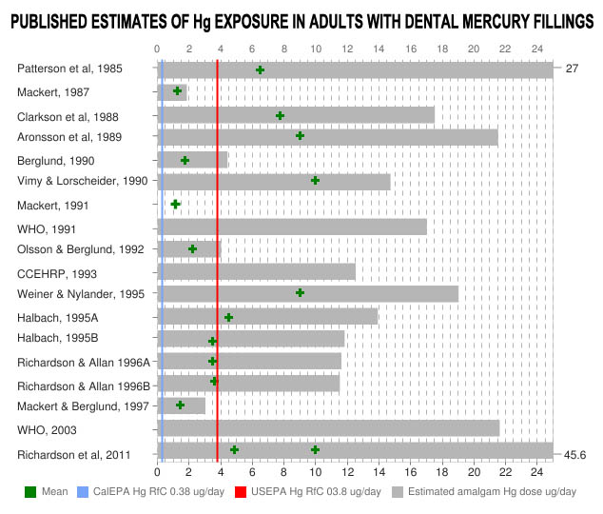
Just a few of the many different Studies done:
Source :http://www.mercuryexposure.info/context/wall-of-shame/item/633-why-does-the-alzheimers-association-ignore-mercury-as-a-causal-factor-in-alzheimers-disease

Slide 20
Source:
WHO (1990). Inorganic Mercury, World Health Organization, International Programme on Chemical Safety, Geneva
WHO (1991). Inorganic Mercury, World Health Organization, International Programme on Chemical Safety, Geneva

Slide 21
Part of the Controversy: The WHO Scandals
The dental division within The WHO has continually released unsanctioned papers promoting the safety of mercury fillings.
1st scandal:
a policy statement was made by the FDI World Dental Federation in 1997 with the title:
WHO Consensus Statement on Dental Amalgam
This policy statement has incorrectly and extensively been used by dental organizations to convince politicians and other decision makers that the WHO has declared mercury fillings safe.
2nd Scandal:
A constructive meeting of many amalgam stakeholders in 2009, where an agreement was reached to "phase down" amalgam, WHO dentist P. E. Petersen was assigned to write up the notes. Instead, Petersen secretly assembled three other pro-mercury dentists, all from developed countries, and produced a paper denying progress could be made on amalgam and making a series of provably false claims about amalgam and about the progress of that stakeholder meeting.
After those attending the meeting proved that the Petersen Paper in no way reflected what occurred there, a world uproar ensued, led by leaders of the World Alliance for Mercury-Free Dentistry. The United Nations Environmental Programme (UNEP) showed great integrity, insisting that the Petersen Paper be withdrawn or else all reference to UNEP removed.
The WHO Oral Health Division was forced to withdraw it on the grounds that it contained misleading and incorrect statements and a correct report has not yet emerged two years after the consultation

Slide 22
Visual Evidence of Mercury Vapor
http://www.youtube.com/watch?feature=player_embedded&v=_6ry_ve6Lr4#!
http://www.kickstarter.com/projects/mercuryexposure/you-put-what-in-my-mouth

Slide 23
According to a 2009 statement by the ADA,
"Dental amalgam is considered a safe, affordable and durable material that has been used to restore the teeth of more than 100 million Americans. It contains a mixture of metals such as silver, copper and tin, in addition to mercury, which binds these components into a hard, stable and safe substance. Dental amalgam has been studied and reviewed extensively, and has established a record of safety and effectiveness.”
Source: (http://www.ada.org/1741.aspx)

Slide 24
“ The FDA has reviewed the best available scientific evidence to determine whether the low levels of mercury vapor associated with dental amalgam fillings are a cause for concern. Based on this evidence, FDA considers dental amalgam fillings safe for adults and children ages 6 and above. The amount of mercury measured in the bodies of people with dental amalgam fillings is well below levels associated with adverse health effects. Even in adults and children ages 6 and above who have fifteen or more amalgam surfaces, mercury exposure due to dental amalgam fillings has been found to be far below the lowest levels associated with harm. Clinical studies in adults and children ages 6 and above have also found no link between dental amalgam fillings and health problems.”
On July 28th, 2009 FDA issued a final regulation classifying dental amalgam and its component parts (elemental mecury and a powder alloy) as Class II medical devices.
Source: (http://www.fda.gov/MedicalDevices/ProductsandMedicalProcedures/DentalProducts/DentalAmalgam/ucm171094.htm)

Slide 25
Corruption in the FDA? The current FDA Commissioner, Margaret Hamburg, coming to FDA from Henry Schein, Inc., the largest seller of dental products and a major seller of medical products and dental amalgam. Source:http://www.mercuryexposure.info/scandals/food-drug-administration/item/763-fda-commissioner-margaret-hamburg-and-conflicts-of-interest-with-mercury-filling-rule

Slide 26
Your Argument makes sense… Mercury is Safe in Our Mouths but… not in the Environment?
Amalgam removed from teeth is classified as toxic waste in various countries, but in many countries it is not regulated, including the United States.
In 2008 Norway and Denmark Banned the use of mercury in dental amalgam.
In 2009 Sweden banned the use of mercury in products, including mercury in dental amalgams, for environmental reasons.
In 1988 the EPA labeled the materials used in dental amalgams, and the amalgam particulates removed from teeth as toxic waste material.

Slide 27
Mercury from dental offices contributes significantly to the overall mercury contamination in wastewater.
In an August 2008 on the dental industry, EPA estimated that in 2008 there were approximately 122,000 dental offices that used or removed dental amalgam in the U.S., and that those offices discharged approximately 3.7 tons of mercury each year to Publically owned Treatment Works (POTWs).
A 2002 study by the New York Academy of Sciences, indicated that as much as 40 percent of total mercury loadings in the New York/New Jersey harbor and watershed may have come from dental offices.
In another study in 2002, the National Association of Clean Water Agencies (NACWA) estimated that nearly 40 percent of the mercury in the nation’s wastewater system came from dental offices, and that mercury discharged from dental offices far exceeded all other commercial and residential sources, each of which was below ten percent.
Source: (http://www.epa.gov/hg/pdfs/dental-module.pdf)

Slide 28
Hope for the Future?
September 27, 2010
EPA announces intent to regulate dental mercury waste
The EPA announced plans to initiate an effluent guideline rulemaking procedure to reduce mercury waste from dental facilities. The EPA said it expects to issue a draft proposal next year that would take effect in 2012
Source : (http://www.ada.org/news/4815.aspx)

Slide 29
EPA announces intent to regulate dental mercury waste but it is not yet regulated. So…
Mercury continues to find its way into our environment through the ground and through the air.
The EPA acknowledges that mercury from amalgam is a source of controllable pollution; that mercury is released into the environment through cremation of bodies containing dental amalgam.
Mercury ends up in our groundwater through landfills and through the POTWS that are only effective at removing 90% of the amalgam waste.
Source: (http://www.epa.gov/hg/pdfs/dental-module.pdf)

Slide 30
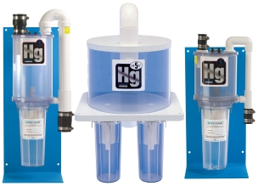
Any responsible dentists out there?
Dentists may choose to voluntarily act in an environmentally responsible fashion.
Separators may dramatically decrease the release of mercury into the public sewer system, but they are not required in the United States.
Amalgam Separators are over 95% effective
Source: (http://www.epa.gov/hg/pdfs/dental-module.pdf)

Slide 31
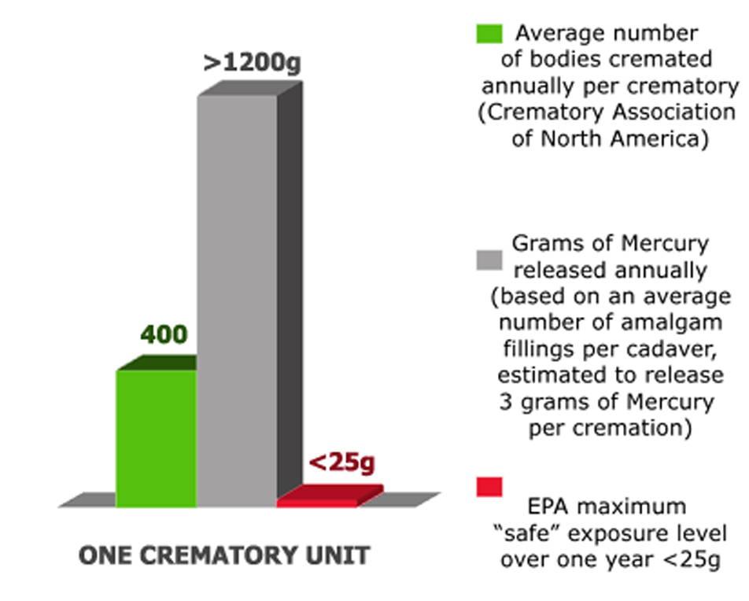
Don’t live downstream from a crematorium!
A worksheet from EPA in 2005 estimated that US emissions from crematoria to be 3,000 kilograms (6,613 lbs)
EPA intends to update mercury emissions, but “does not intend to regulate human crematoriums at this time.”
EPA has concluded that human crematories were not solid waste incinerators; therefore it was not appropriate to regulate them under Clean Air Act Section 129.
Image Source : http://no2crematory.wordpress.com/the-toxic-truth-data/

Slide 32
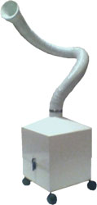
Guidelines for “Safe” Amalgam Removal
1. Keep the fillings cool during removal with water and air.
Drilling out an amalgam filling generates a tremendous amount of heat, which causes a significant increase in the release of mercury, both as a vapor and in amalgam particles, during the entire removal process.
2. Cutting the Amalgam into Chunks
Most mercury-safe dentists use a removal process that’s commonly
referred to as chunking. This involves less drilling, because the
dentist only drills enough to cut the filling into chunks, which
can then be easily removed by a hand instrument or suction.
3. Use a high-volume evacuator
Most mercury safe dentists use a more powerful suction system.
The evacuator tip should be kept to within 1⁄2 inch of the filling
during the entire time the filling is being removed. This helps capture
more of the mercury vapor and particles.
4. Provide the patient with an alternative source of air
Positive pressure oxygen should be given to you through an oxygen
mask during the mercury filling removal, so that you will not inhale
the mercury vapor that is released.
Source: (http://dentalwellness4u.com/freeservices/amalremov2.html)
Source: (http://www.dentairvac.com/images/dav_vii_225.jpg)

Slide 33
Insurance Companies
What insurance companies cover also varies from company and policy.
Most dental insurance plans cover the cost of dental amalgam and gold fillings, since they are used for functional, rather than exclusively cosmetic, purposes. Many plans cover the cost of composites up to the price of amalgam fillings, especially if an amalgam filling is chipped or cracked.
What counts as cosmetic?
Veneers
Removal of amalgam fillings
Teeth whitening

Slide 34
The Future: Safer Filling alternatives
All filling materials have their pros and cons, in my opinion none of the cons are as bad as the cons of amalgam fillings. Cons of choosing any of these alternative restorative materials result in your insurance company most likely not covering them.
Composite resins are tooth-colored fillings. Your dentist may use them on your front teeth, where appearance is important
Pros -. Composite resin is easier than gold for a dentist to work with and usually is less expensive than gold.
Cons - may contain BPA
Ionomers are tooth-colored materials that dentists often use for small cavities or cavities between teeth.
Pro - glass ionomer – needs no electricity, needs only small hand tools, costs half the price as amalgam, easy to do-can be placed by dental hygienist. Some ionomers release small amounts of fluoride, which may help you if you often get cavities.
Con - Some ionomers release small amounts of fluoride
Gold is costly and is harder for your dentist to work with. This makes the procedure take longer and cost more.
Ceramics (porcelain) are costly tooth-colored fillings. They require special equipment and may require dental lab support. You may need several appointments
Source: (http://www.webmd.com/oral-health/fillings-restorations)

Slide 35
The environmental pollution of mercury imposes health risks upon the surrounding population; in economics this pollution is considered an external cost not factored into the private costs of using dental amalgam.

Slide 36
Bibliography:
Bjorkman L; Sandborgh-Englund G;Ekstarnd J. “Mercury in Saliva and Feces After Removal of Amalgam Fillings” ToxicolApplPharmacol 144(1):156-62, May 1997
.Ekstrand J; Bjorkman L; Edlund C; Sandborgh-Englund G. “Toxicological
Aspects of the Release and Systemic Uptake of Mercury from Dental
Amalgam” EurJOralSci 106(2pt2):678-86, Apr 1998
.Rivola J; Krejci I; Imfeld T; Lutz F. « Cremation and the Environmental Mercury
Burden » Schweiz Monatsschr Zahnmed 100(11):1299-303, 1990
Dental and Health Facts Newsletter, Fdn for Toxic Free Dentistry, Vol.5, No.3 Sept 1992.
ATSDR. 1999. Toxicological Profile for Mercury. Atlanta, GA:Agency for Toxic Substances and Disease Registry. http://www.atsdr.cdc.gov/toxprofiles/tp46.pdf
Randall, M. (September 26, 2012.). You put What in My Mouth?. Retrieved October 2, 2012, from http://iaomt.org/
No Author, (August, 2009). Statement on Dental Amalgam. Retrieved October 2, 2012, from http://ada.org
No Author, (September, 2010). 2010 General Assembly Resolution on Dental Amalgam. Retrieved October 2, 2012, from http://www.fdiworldental.org/
No Author, (October, 2011). Frequently asked questions: mercury and health. Retrieved October 2, 2012, from http://www.who.int/phe/chemicals/faq_mercury_health/en/
http://www.webmd.com/oral-health/fillings-restorations)
Source:http://www.mercuryexposure.info/scandals/food-drug-administration/item/763-fda-commissioner-margaret-hamburg-and-conflicts-of-interest-with-mercury-filling-rule

Slide 37
Bibliography
Jaroff, Leon. (2002). There’s Nothing Dangerous About ‘Silver’ Fillings. TIMES MAGAZINE. Retrieved October 2 from:
http://www.time.com/time/health/article/0,8599,235009,00.html
Carlton, Emmitt H. No Title Retrieved October 2 from:
http://www.mercurypoisoned.com/hearings/carlton_statement.html\
Medical Devices – About Dental amalgam Fillings (08/11/2009) Retrieved September 17th from
http://www.fda.gov/MedicalDevices/ProductsandMedicalProcedures/DentalProducts/DentalAmalgam/ucm171094.htm
No Author. (March 1999). Toxic Substances Portal - Mercury Retrieved September 17th from: http://www.atsdr.cdc.gov/phs/phs.asp?id=112&tid=24
Adams, Mike. (June, 5th 2008). Mercury fillings shattered! FDA, ADA Conspiracy to Poison Children with Toxic Mercury Filling Exposed in Groundbreaking Lawsuit. Retrieved September 17th from: http://www.naturalnews.com/023367_mercury_FDA_the.html
Kemi and Miljo Konsulterna. (December 2005) Free Dental Fillings- Phase Out of amalgam in Sweden. Retrieved September 17th from:
http://www.who.int/ifcs/documents/forums/forum5/pm9_05.pdf
http://www.kickstarter.com/projects/mercuryexposure/you-put-what-in-my-mouth
http://www.youtube.com/watch?v=CrRioKSW0Jg&feature=player_embedded
An animated Anti-mercury video. Created By Youtube User MercuryExposure.
http://www.youtube.com/watch?v=80IhWNTTO38&feature=plcp
NBC: FDA reviews safety of mercury dental fillings
http://www.youtube.com/watch?v=WmKhcqq437M&feature=plcp
Huggins, Hal. A. (1993). It's All in Your Head: The Link Between Mercury Amalgams and Illness. Honesdale, PA: Avery Publishing.
Stortebecker, Patrick. (1999) Mercury Poisoning from Dental Amalgam a Hazard to Human Brain Bio-Probe
Tom McGuire, DDS, (2012). The Poison in Your Teeth: Mercury Amalgam fillings…Hazardous to Your Health! Sebastopol, California: The Dental Wellness Institute, LLC.
Andrew Cutler, Jun 1, (1999). Amalgam Illness: Diagnosis and Treatment. Sammamish, WA:

